Slide 1
Reduced order modelling of fission gas diffusion in columnar grains using SCIANTIX coupled with TRANSURANUS
M. Di Gennaro, D. Pizzocri, F. A. B. Silva, G. Zullo, L. Luzzi
Progress meeting, 11 June 2024

Slide 2

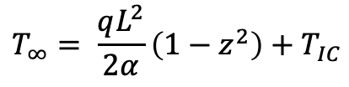

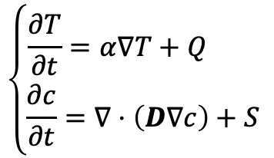
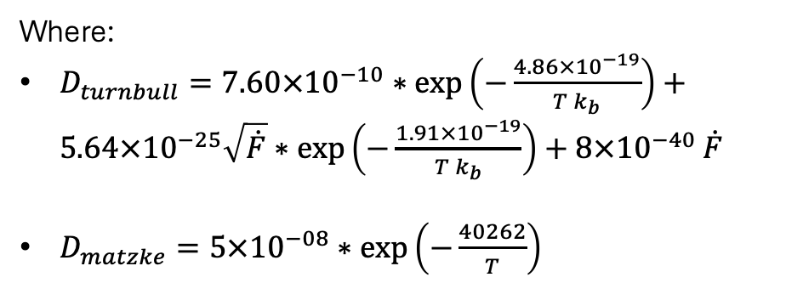
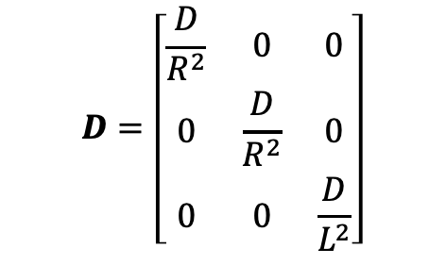
Governing equation
Being $𝒰=H^{1}(Ω)$ the solution space of the non-discretize equations:
$$\left\{\begin{aligned}\frac{∂T}{∂t}=α∇T+Q \\ \frac{∂c}{∂t}=∇⋅\left(D∇c\right)+S\end{aligned}\right.$$
$$T_{∞}= \frac{qL^{2}}{2α}\left(1−z^{2}\right)+T_{IC}$$
$$c_{BC}=0, T_{BC}=T_{IC}, ∇T⋅n=0$$
$$c_{IC}=0$$
Where:
$D_{turnbull}=7.60×{10}^{−10}∗\exp\left(−\frac{4.86×{10}^{−19}}{T k_{b}}\right)+$ $5.64×{10}^{−25}\sqrt{\dot{F}}∗\exp\left(−\frac{1.91×{10}^{−19}}{T k_{b}}\right)+8×{10}^{−40}$ $\dot{F}$
$D_{matzke}=5×{10}^{−08}∗\exp\left(−\frac{40262}{T}\right)$
$$D=\left[\begin{matrix}\frac{D}{R^{2}} & 0 & 0 \\ 0 & \frac{D}{R^{2}} & 0 \\ 0 & 0 & \frac{D}{L^{2}}\end{matrix}\right]$$
Main limitations of the old model (Pizzocri et al. 2023)
Linearization of the diffusion coefficient -> difficulty in capturing exponential behaviour far from the linearization temperature.
Train on a single set of parameters -> no possibility to generalized

Slide 3
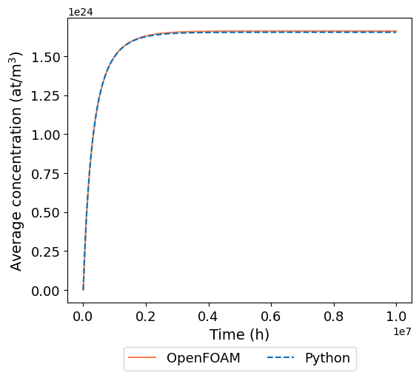
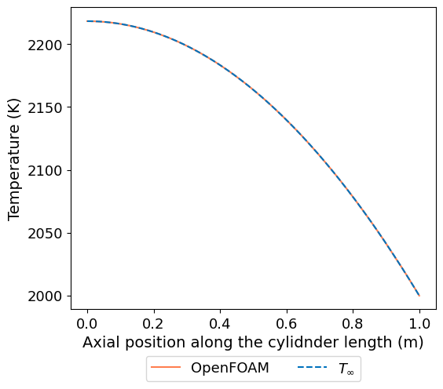
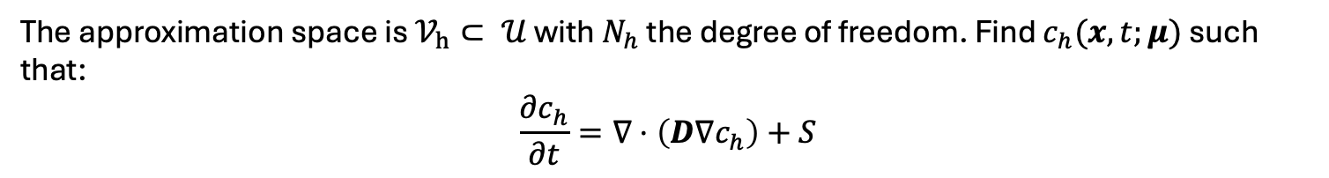
Full order
The approximation space is $𝒱_{h}⊂ 𝒰$ with $N_{h}$ the degree of freedom. Find $c_{h}(x,t;μ)$ such that:
$$\frac{∂c_{h}}{∂t}=∇⋅\left(D∇c_{h}\right)+S$$
In FreeFEM++ is realized the cylinder mesh, the finite element spaces and the matrices.
In Python is solved the linear system with farward Euler.
Check done:
Error at steady state = 0.5%

Slide 4
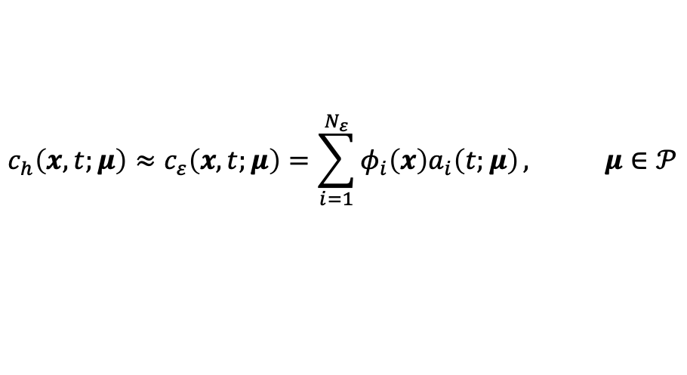

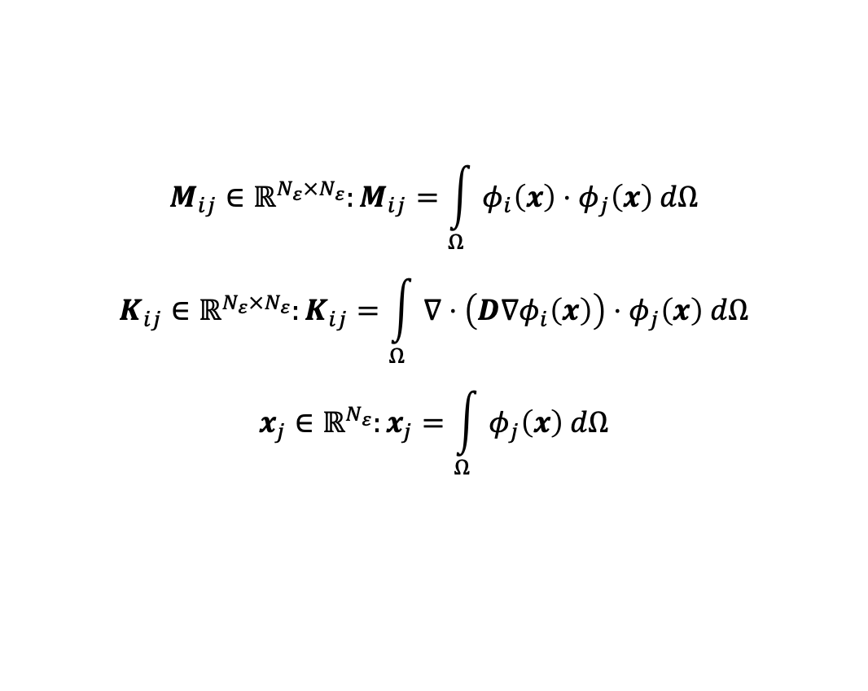
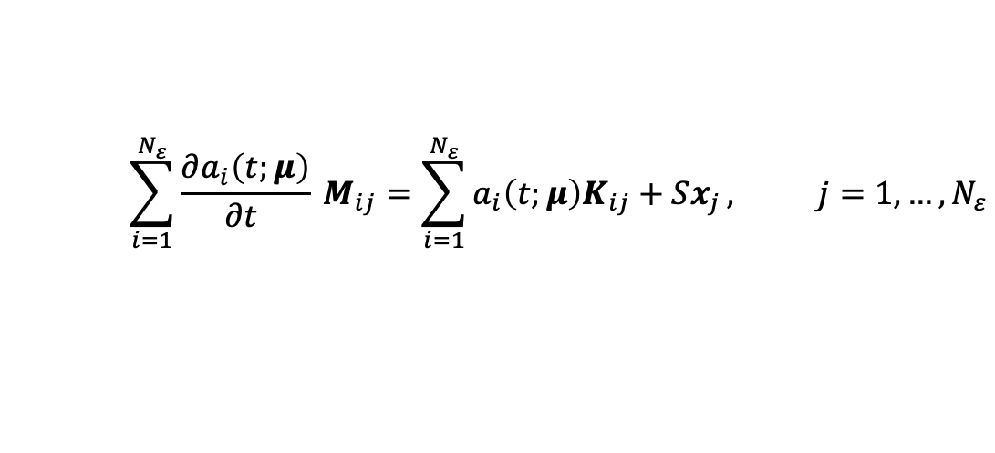
Reduced order model
Once the $N_{ε}$dimensional set of spatial reduced basis functions ${\left\{φ_{i}\left(x\right)\right\}}_{i=1}^{N_{ε}}$the reduced space $𝒱_{ε}⊂𝒱_{h}⊂𝒰$ is constructed. The full model solution $c_{h}$ is approximated by:
$$c_{h}\left(x,t;μ\right)≈c_{ε}\left(x,t;μ\right)=\sum_{i=1}^{N_{ε}}{φ_{i}\left(x\right)a_{i}\left(t;μ\right)}, μ∈𝒫$$
$$\sum_{i=1}^{N_{ε}}{\frac{∂a_{i}\left(t;μ\right)}{∂t }} M_{ij}=\sum_{i=1}^{N_{ε}}{a_{i}\left(t;μ\right)K_{ij}+Sx_{j}}, j=1, …,N_{ε}$$
Being $φ_{j}\left(x\right)$ the test functions:
$$M_{ij}∈ℝ^{N_{ε}×N_{ε}}:M_{ij}=\int_{Ω}{φ_{i}\left(x\right)⋅φ_{j}\left(x\right) dΩ}$$
$$K_{ij}∈ℝ^{N_{ε}×N_{ε}}:K_{ij}=\int_{Ω}{∇⋅\left(D∇φ_{i}\left(x\right)\right)⋅φ_{j}\left(x\right) dΩ}$$
$$x_{j}∈ℝ^{N_{ε}}:x_{j}=\int_{Ω}{φ_{j}\left(x\right) dΩ}$$
Mass matrix
Stiffness matrix
Source vector

Slide 5
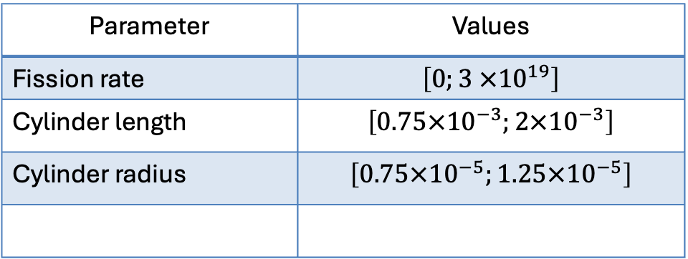

Reduced order model: training set
$$Ξ_{train}={\left\{μ_{p}\right\}}_{p=1}^{P}⊂𝒫$$
Random samples from a uniform distribution in $𝒫$ of 10’000 values.
Parameter | Values
Fission rate | $$\left[0;3 ×{10}^{19}\right]$$
Cylinder length | $$\left[0.75×{10}^{−3};2×{10}^{−3}\right]$$
Cylinder radius | $$\left[0.75×{10}^{−5};1.25×{10}^{−5}\right]$$
Values determined based on the SUPERFACT-1 and SPHERE irradiation experiments.

Slide 6
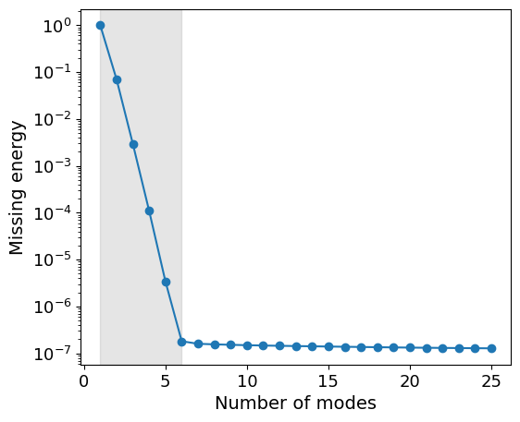
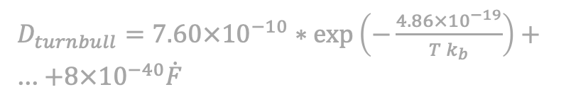
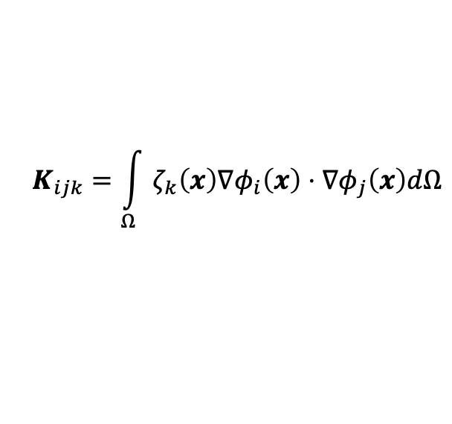


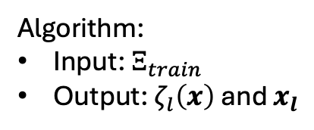


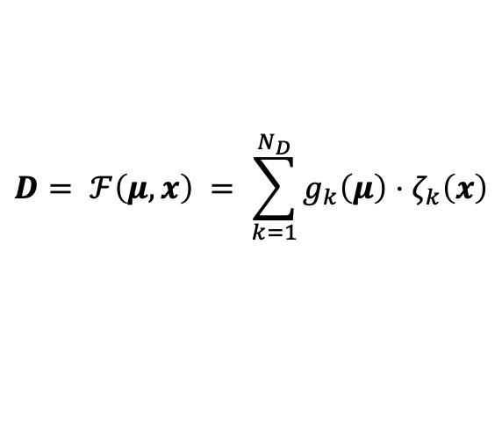

DEIM: construction of affine decomposition
Discrete Empirical Interpolation Method (DEIM):
$$μ_{1}$$
$$μ_{2}$$
$$D= ℱ\left(μ, x\right) = \sum_{k=1}^{N_{D}}{g_{k}\left(μ\right)⋅ζ_{k}\left(x\right)}$$
$D_{turnbull}=7.60×{10}^{−10}∗\exp\left(−\frac{4.86×{10}^{−19}}{T k_{b}}\right)+$ … $+8×{10}^{−40}\dot{F}$
computed during the online phase
$$μ_{3}$$
The stiffness matrix is rewritten in this way:
$$K_{ijk}=\int_{Ω}{ζ_{k}\left(x\right)∇φ_{i}\left(x\right)⋅∇φ_{j}\left(x\right)dΩ}$$
$$N_{D}=6$$
$$K_{ij,k}∈ℝ^{N_{D}×N_{ε}×N_{ε}}$$
Algorithm:
Input: $Ξ_{train}$
Output: $ζ_{l}\left(x\right)$ and $x_{l}$
Are the interpolation points used during the online phase.
Notes:
Con il DEIM decomponiamo affinamente la stiffness cosi da avere un problema lineare.

Slide 7
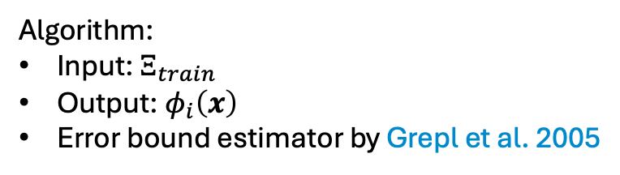
POD-greedy
Algorithm:
Input: $Ξ_{train}$
Output: $φ_{i}\left(x\right)$
Error bound estimator by Grepl et al. 2005

Slide 8
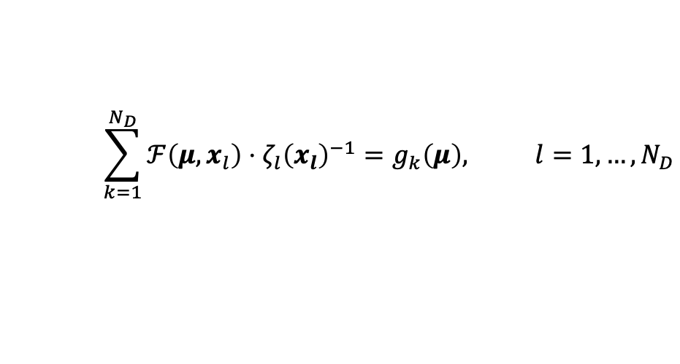
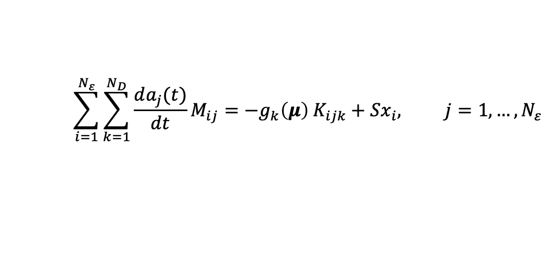
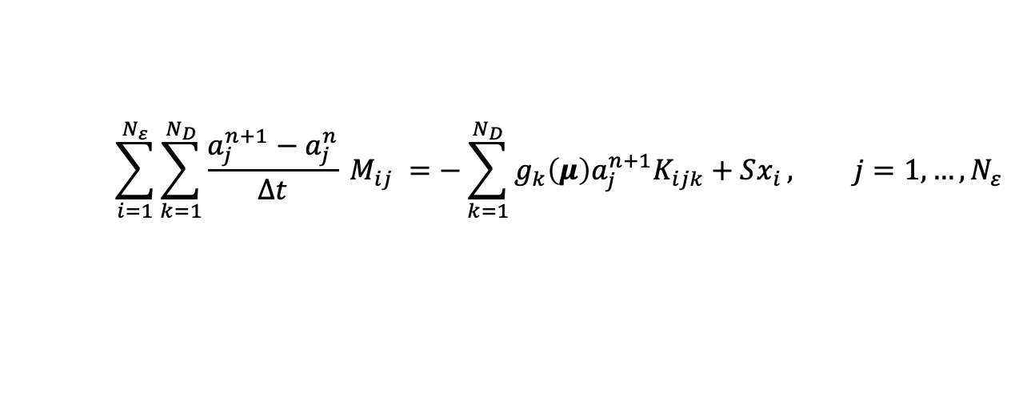
Online stage
$$\sum_{k=1}^{N_{D}}{ℱ\left(μ, x_{l}\right)⋅ζ_{l}{\left(x_{l}\right)}^{−1}}=g_{k}\left(μ\right), l=1, …, N_{D}$$
$$\sum_{i=1}^{N_{ε}}{\sum_{k=1}^{N_{D}}{\frac{da_{j}(t)}{dt}M_{ij}}}=−g_{k}\left(μ\right) K_{ijk}+Sx_{i}, j=1, …, N_{ε}$$
Farward Euler
$$\sum_{i=1}^{N_{ε}}{\sum_{k=1}^{N_{D}}{\frac{a_{j}^{n+1}−a_{j}^{n}}{Δt} M_{ij}}} =−\sum_{k=1}^{N_{D}}{g_{k}\left(μ\right)a_{j}^{n+1}K_{ijk}+Sx_{i}}, j=1, …, N_{ε}$$

Slide 9
Computational times

Slide 10
Future developments

Slide 11
Thank you for your kind attention

Slide 12
Literature
Forsberg, K., Massih, A.R., 1985. Fission gas release under time-varying conditions. Journal of Nuclear Materials 127, 141–145. doi:10.1016/0022-3115(85)90348-4.
Olander, D.R., 1976. Fundamental Aspects of Nuclear Reactor Fuel Elements, Technical Information Center – Energy Research and Development Administration, University of California, Berkeley, CA, USA.
Pastore, G., Swiler, L.P., ... Williamson, R.L., 2015. Uncertainty and sensitivity analysis of fission gas behavior in engineering-scale fuel modeling. Journal of Nuclear Materials 456, 398–408. doi:10.1016/j.jnucmat.2014.09.077.
Pastore, G., Pizzocri, D., Luzzi, L., 2018. An effective numerical algorithm for intra-granular fission gas release during non-equilibrium trapping and resolution. Journal of Nuclear Materials 509, 687–699. doi:10.1016/j.jnucmat.2018.07.030.
Pizzocri, D., Rabiti, C., Luzzi, L., Barani, T., Van Uffelen, P., & Pastore, G. 2016. PolyPole-1: An accurate numerical algorithm for intra-granular fission gas release. Journal of Nuclear Materials, 478, 333–342. https://doi.org/10.1016/j.jnucmat.2016.06.028.
Pizzocri, D., Di Gennaro, M., Barani, T., Silva, F. A. B., Zullo, G., Lorenzi, S., & Cammi, A. 2023. A reduced order model for fission gas diffusion in columnar grains. Nuclear Engineering and Technology, 55(11), 3983–3995. https://doi.org/10.1016/j.net.2023.07.013
Sirovich, L., 1987. Turbulence and the dynamics of coherent structures. I. Coherent structures. Quarterly of Applied Mathematics 45, 561–571. doi:10.1090/qam/910462.

Slide 13
Backup slides

Slide 14
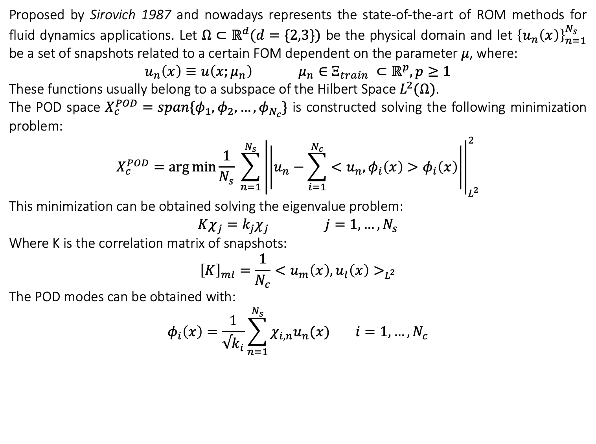
Proper Orthogonal Decomposition procedure
Proposed by Sirovich 1987 and nowadays represents the state-of-the-art of ROM methods for fluid dynamics applications. Let $Ω⊂ℝ^{d}(d=\{2,3\})$ be the physical domain and let ${\left\{u_{n}\left(x\right)\right\}}_{n=1}^{N_{s}}$ be a set of snapshots related to a certain FOM dependent on the parameter $μ$, where:
$$u_{n}\left(x\right)≡u\left(x;μ_{n}\right) μ_{n}∈Ξ_{train} ⊂ℝ^{p}, p≥1$$
These functions usually belong to a subspace of the Hilbert Space $L^{2}(Ω)$.
The POD space $X_{c}^{POD}=span\{φ_{1},φ_{2}, …,φ_{N_{c}}\}$ is constructed solving the following minimization problem:
$$X_{c}^{POD}=\arg{\min{\frac{1}{N_{s}} \sum_{n=1}^{N_{s}}{{\left|\left|u_{n}−\sum_{i=1}^{N_{c}}{<u_{n}, φ_{i}\left(x\right)>φ_{i}\left(x\right)}\right|\right|}_{L^{2}}^{2}}}}$$
This minimization can be obtained solving the eigenvalue problem:
$Kχ_{j}=k_{j}χ_{j} j=1,…, N_{s}$
Where K is the correlation matrix of snapshots:
$${\left[K\right]}_{ml}=\frac{1}{N_{c}}<u_{m}\left(x\right), u_{l}\left(x\right)>_{L^{2}}$$
The POD modes can be obtained with:
$$φ_{i}\left(x\right)=\frac{1}{√k_{i}}\sum_{n=1}^{N_{s}}{χ_{i,n}u_{n}(x)} i=1,…, N_{c}$$

Slide 15
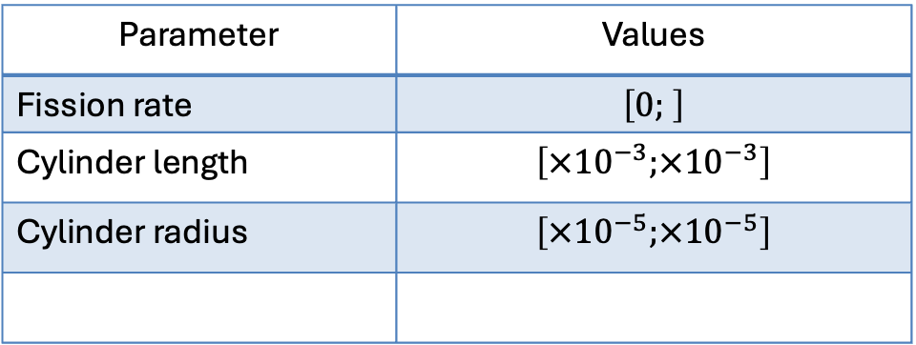
SUPERFACT
Parameter | Values
Fission rate | $$\left[0; \right]$$
Cylinder length | $$\left[×{10}^{−3};×{10}^{−3}\right]$$
Cylinder radius | $$\left[×{10}^{−5};×{10}^{−5}\right]$$

